Slide 1


Slide 2
Last Progress

Slide 3
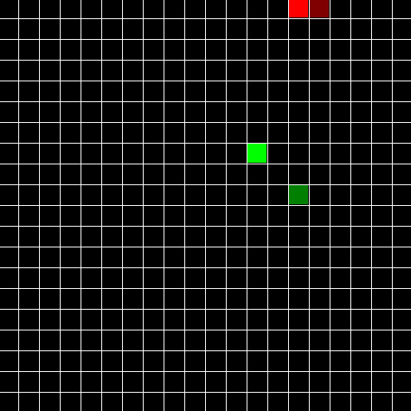
Last Progress
Problem : 센서에 감지된 것이 없을 때?

Slide 4
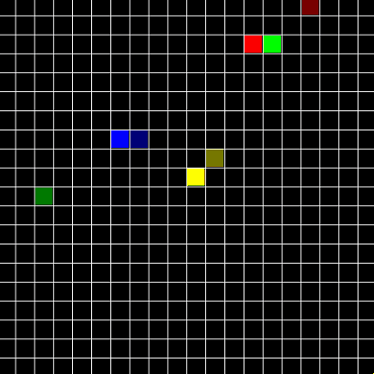
Last Progress
Problem : 장애물을 어떻게 감지할까?

Slide 5
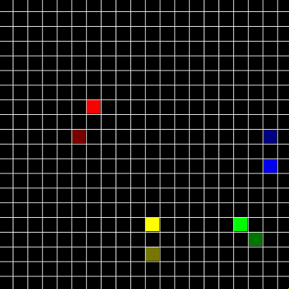
Last Progress
Problem : 무한루프

Slide 6
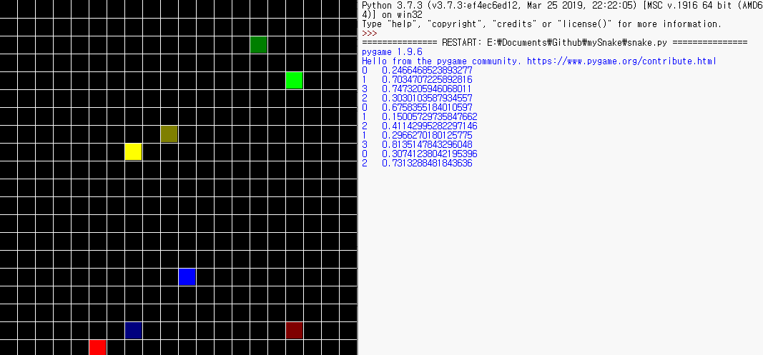
Last Progress

Slide 7
Current Progress

Slide 8


Current Progress
TCP/IP Socket

Slide 9
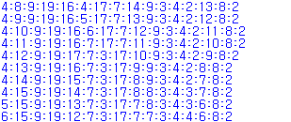
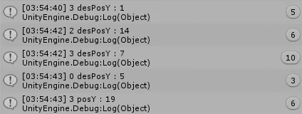
Current Progress
sendMassage
cube.pos.x + ":" + cube.pos.y + ":" + dst.pos.y + ":" + dst.pos.y

Slide 10
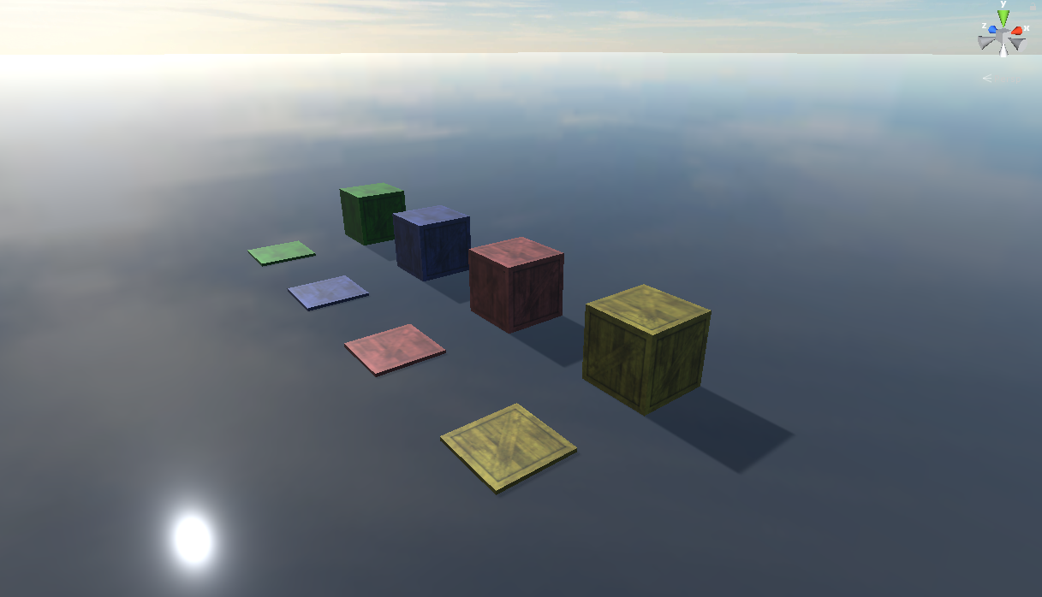
Current Progress

Slide 11

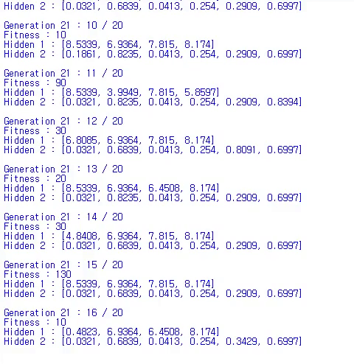
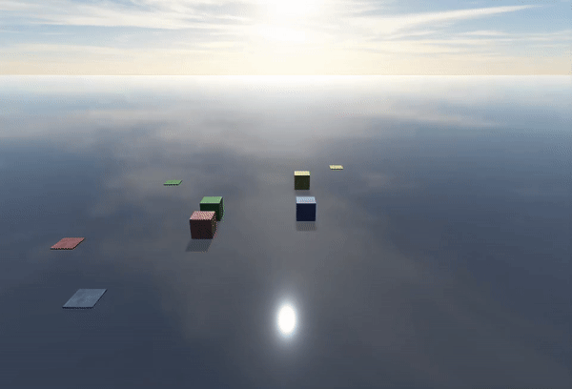
Current Progress

Slide 12
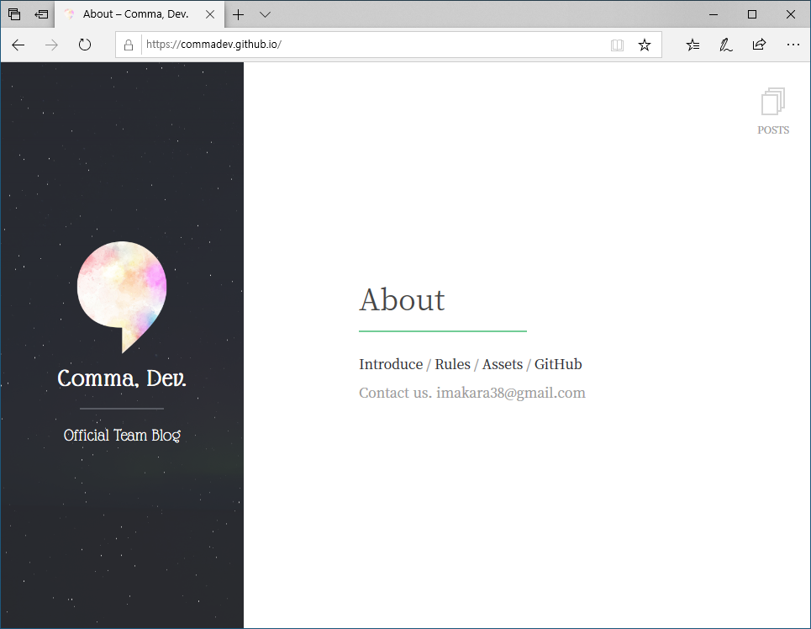
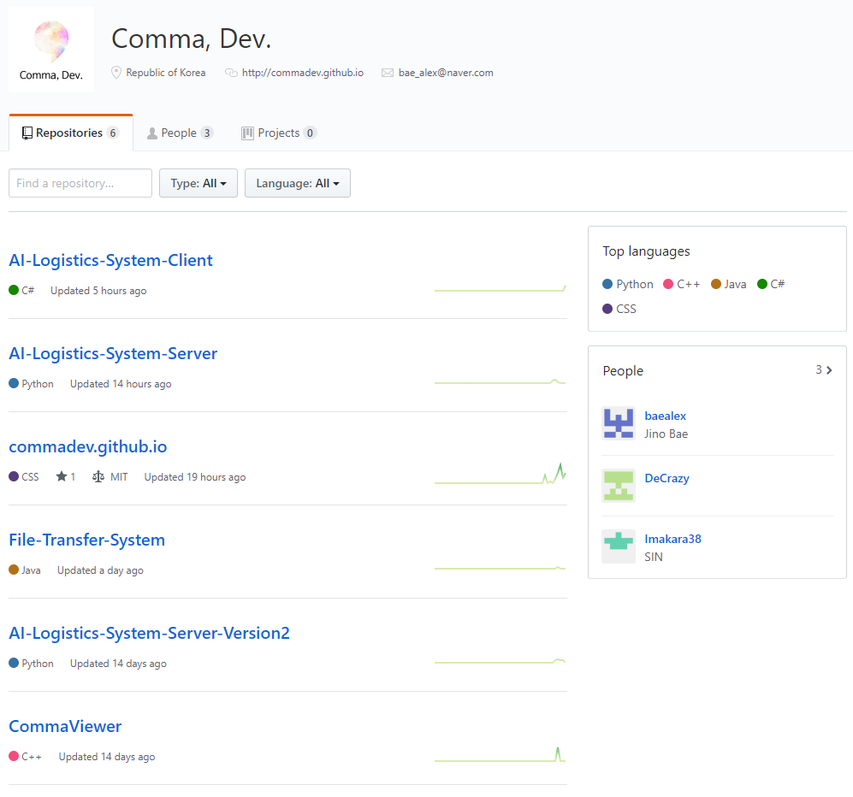
Current Progress

Slide 13
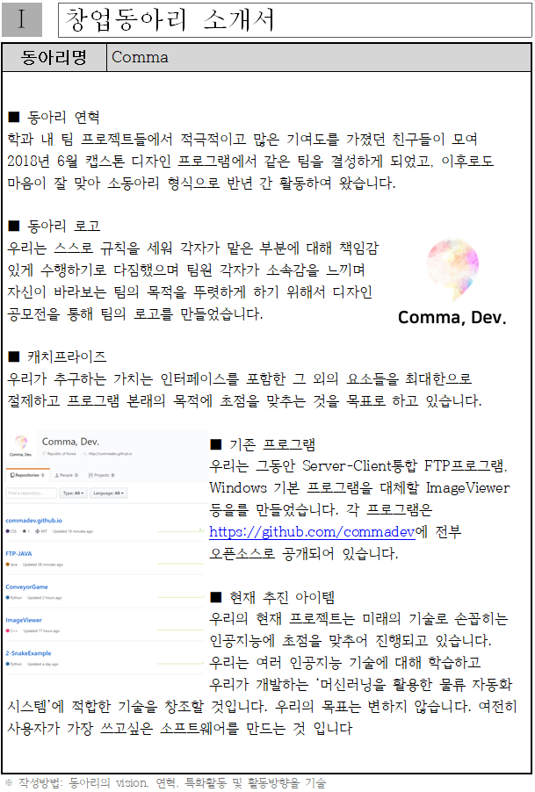
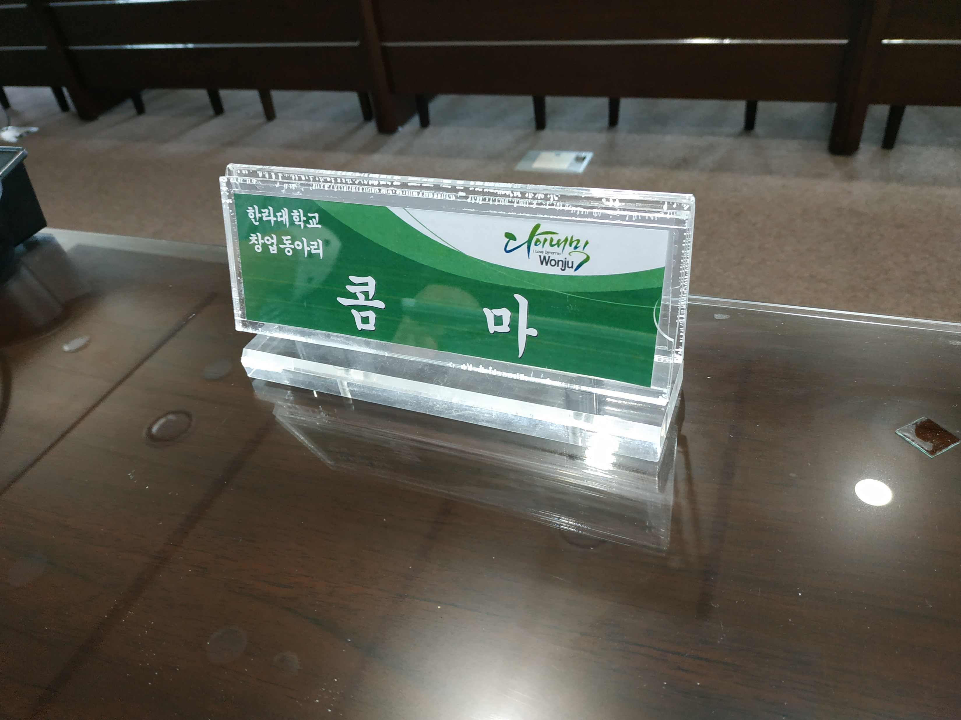
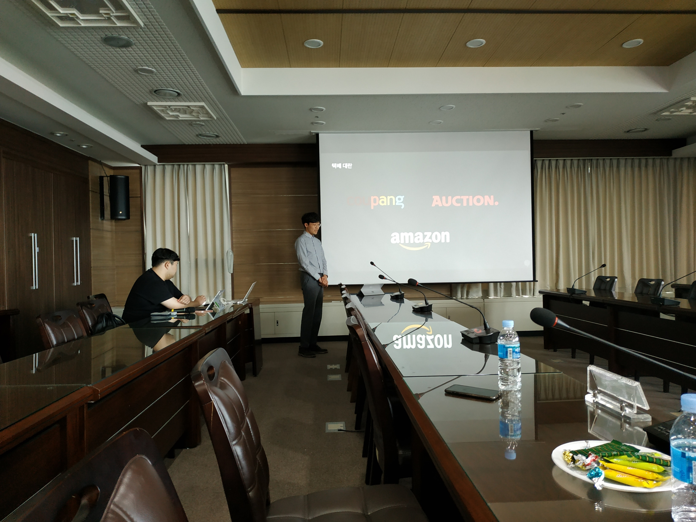
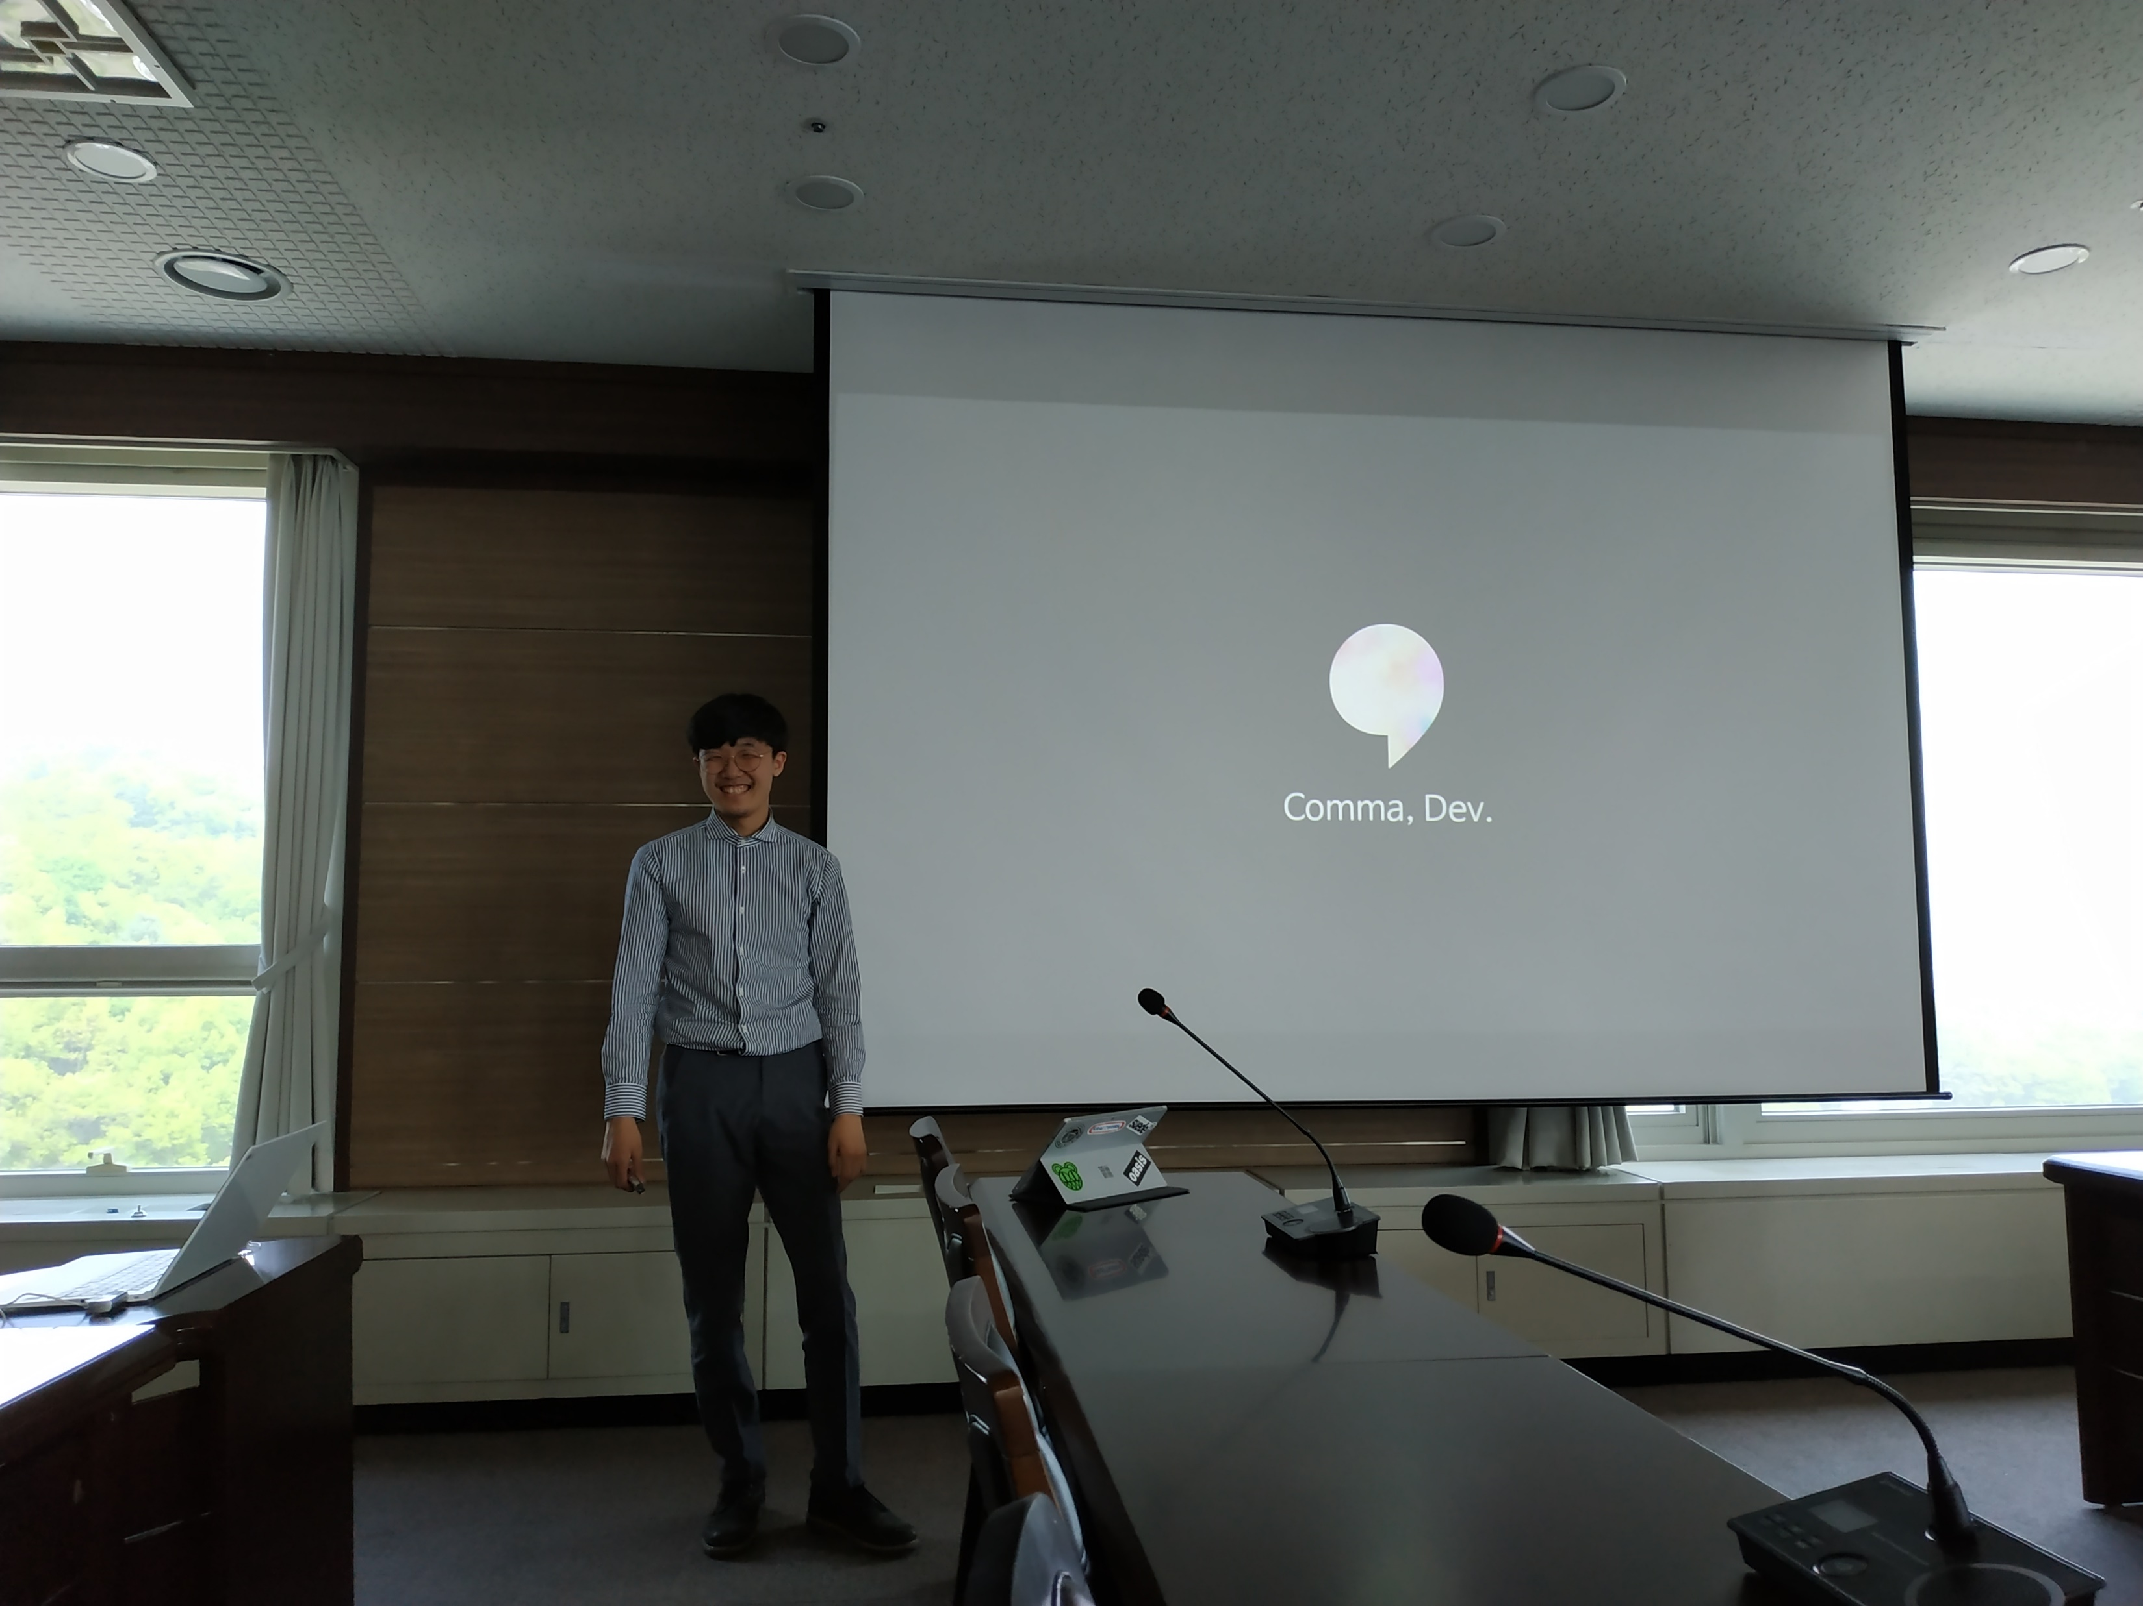
Current Progress

Slide 14
Next Progress

Slide 15

Next Progress

Slide 16
Q&A

Slide 17
Thank You

